Slide 1


Hardware Software Platforms Project Presentation
Design of a I2C Driver for a Digital Compass
Drescigh Lucien lucien.drescigh@student.umons.ac.be
Gencsek Ewan ewan.gencsek@student.umons.ac.be
GitHub repository: https://github.com/CienDrs/Hardware_Software_compass

Slide 2
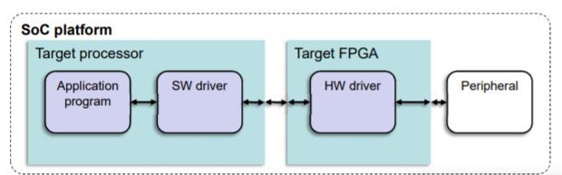
Project goals
Create a tutorial based on Quartus and DE0-nano kits on how to design a I2C driver for a digital compass

Slide 3
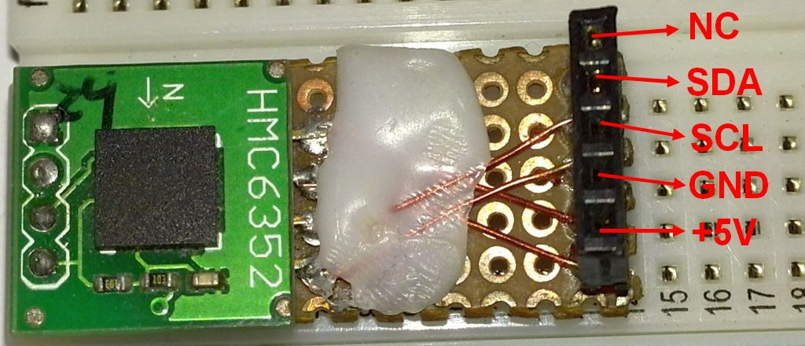
The HMC6352
The HMC635 is a compass module that combines 2-axis magneto-resistive sensors
The address of the device is 41(hex).
The slave address is 42(hex) for write operations and 43(hex) for read operations.

Slide 4
The I2C Protocol
A master I2C module was used to implement the bloc file, based on the state machine.
Multiple states with transition conditions.

Slide 5
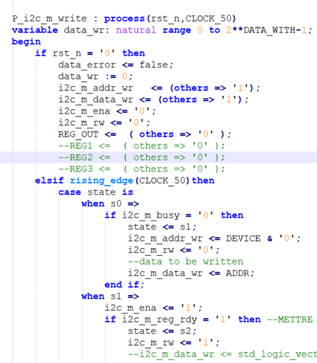
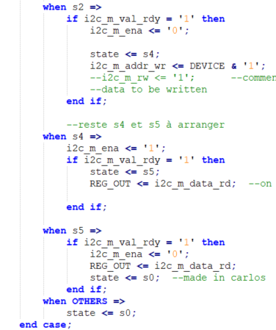
I2C used in the Bloc file

Slide 6
Test bench
Create the test bench file.
Set the code as a top-level entity. To do so, click on Assignments -> Settings, General.
Change the type of the file as VHDL Test Bench File by right-clicking on it in the project navigator.
Compile the project. Warning: Altera is more reliable than ModelSim !
Your test bench is ready !

Slide 7
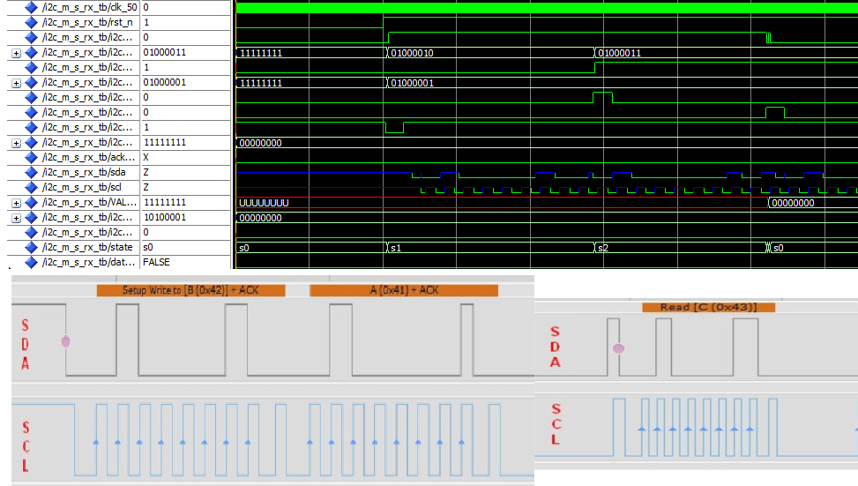
Test bench

Slide 8
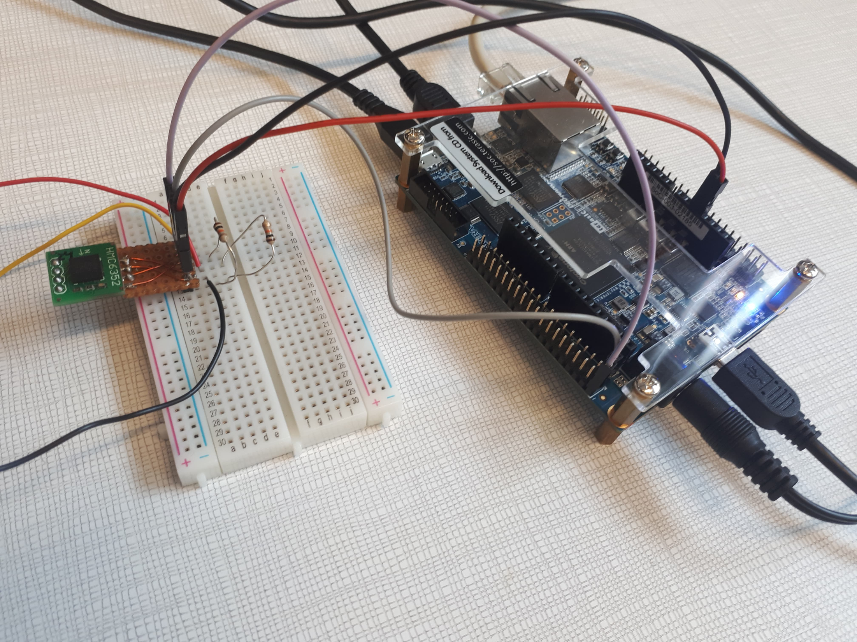
Experimental setup
We connected the GPIO-0 and GPIO-1 of the FPGA to the serial data and the serial clock branches of the compass.
We also put pull-up resistors to avoid leaving a floating line in a circuit.

Slide 9
Tutorial
Configuration of the FPGA
Open the quartus project archive (soc_system_Lucien_Ewan.qar file)
Tools -> Programmer
Select the hardware
Start the configuration of the FPGA

Slide 10
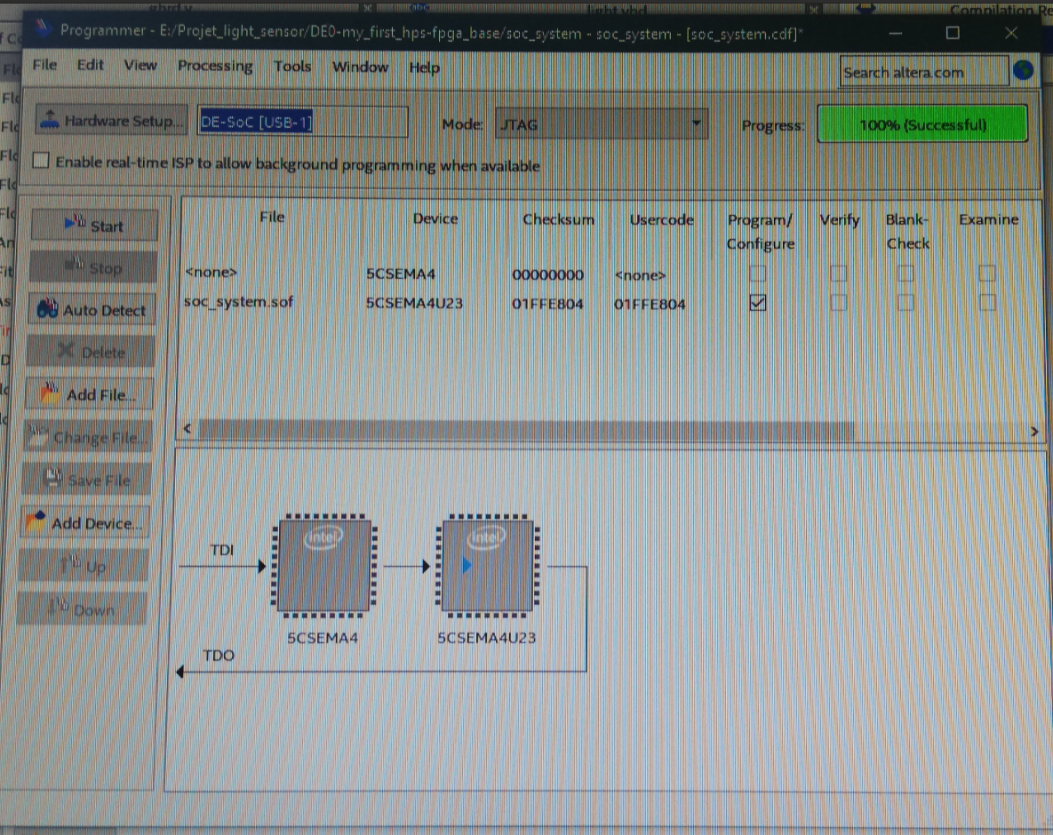
Tutorial

Slide 11
Main.c
C code to print the values returned by the sensor

Slide 12
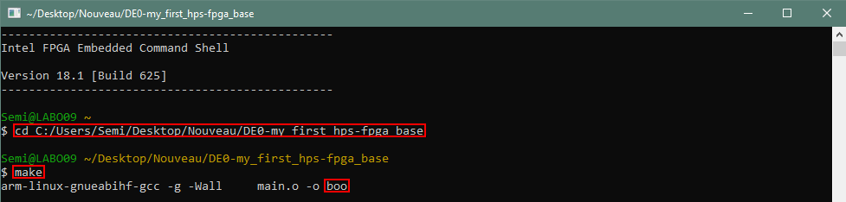
Tutorial
EDS and Makefile
Open EDS and go to your project file directory
Create a file with the makefile (which is in your file directory) and the command make in EDS prompt

Slide 13
Tutorial
Putty
Open Putty on your computer
Connect to the FPGA processor
With command prompt upload the executable file
With Putty launch the executable file

Slide 14
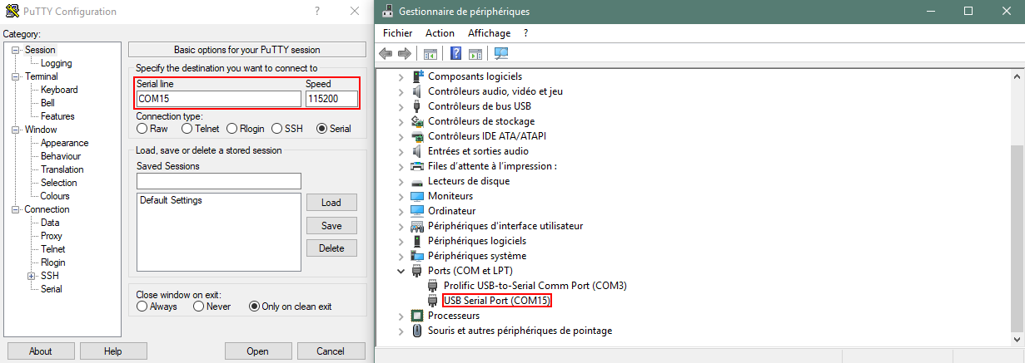
Tutorial
Putty

Slide 15
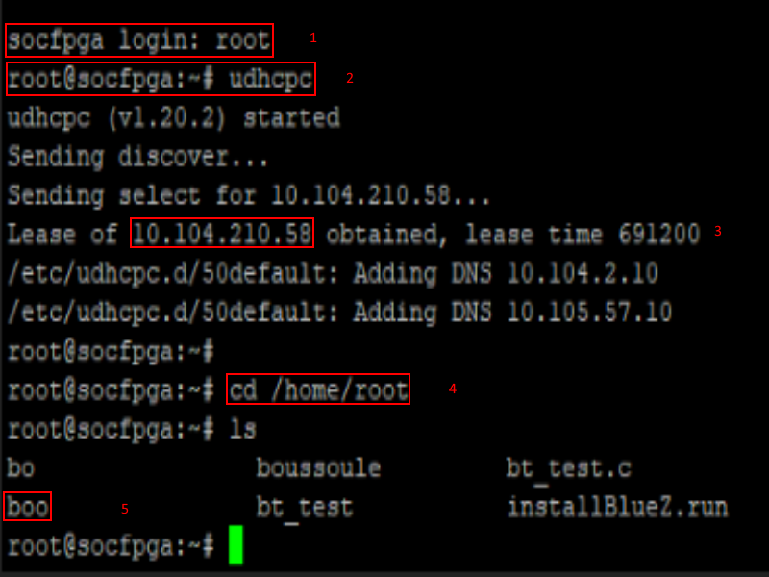
Tutorial
Putty

Slide 16
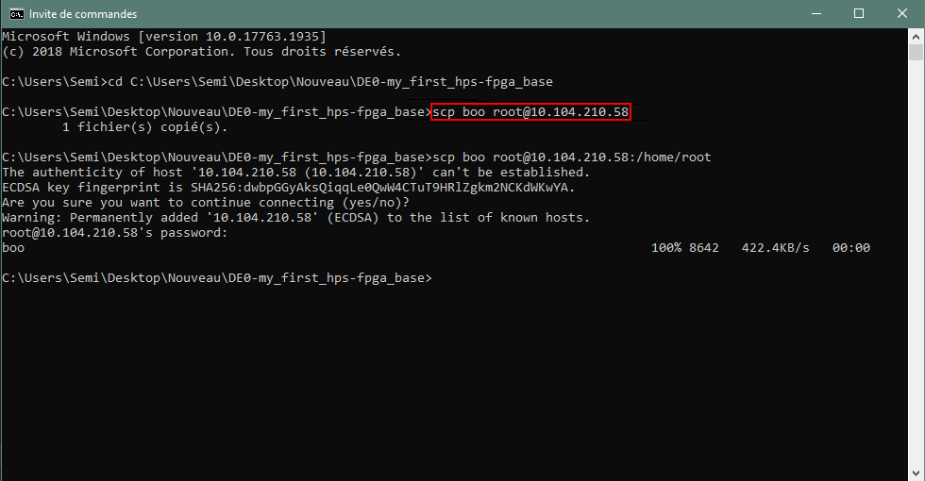
Tutorial
Command prompt

Slide 17
Tutorial
Putty
The result of the read out of the sensor is shown on the Putty prompt
You have to do the connection with Putty before the configuration because when the FPGA is turned off the hardware is reset

Slide 18
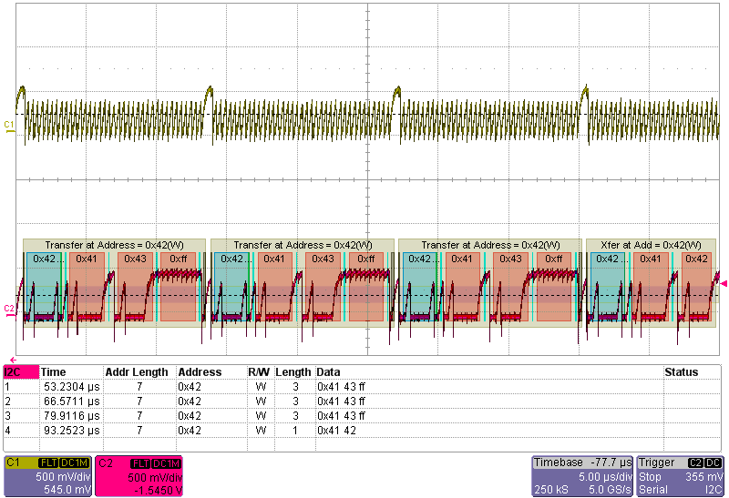
Experimental Results

Slide 19
Demonstration Video
https://www.youtube.com/watch?v=WFVLfnYO3oo

Slide 20
Conclusion
Deepen of our knowledge in VHDL and Altera Quartus
Former theorical courses were applied in a concrete project
This work can be translated into other progamming languages

Slide 21
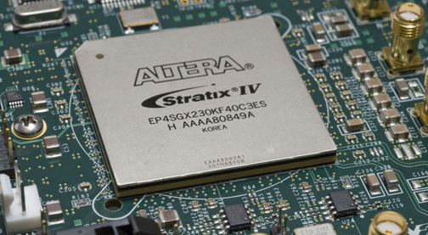
Questions ?

